Slide 1


Efficient Thermal Insulation Design for Industrial Pipelines
(Reducing Heat Loss While Minimizing Insulation Material Cost)
KAVINRAJA CHAKRAVARTHY
Kavinraja Chakravarthy

Slide 2
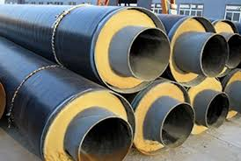
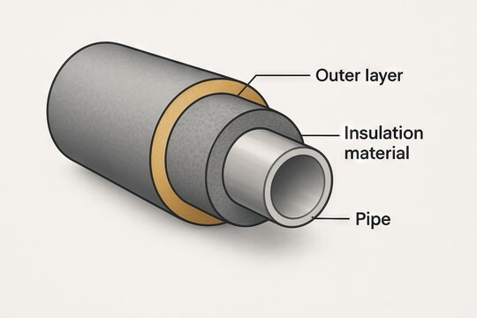
Problem Statement
In industrial plants, hot fluids are transported through pipes.
Insulation is provided to reduce heat loss to the surroundings.
However:
  Insufficient insulation → excessive heat loss and energy wastage
  Excessive insulation → unnecessary material and installation cost
Engineering challenge:
Determine the optimal insulation thickness that minimizes heat loss and total cost.
KAVINRAJA CHAKRAVARTHY
Kavinraja Chakravarthy

Slide 3
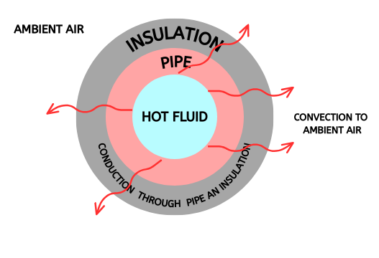
Heat Transfer Mechanism in Insulated Pipes
Heat transfer from a hot pipe occurs mainly by:
  Conduction through pipe wall and insulation
  Convection from outer insulation surface to ambient air
For long pipes under steady state, heat transfer is treated as
one-dimensional radial heat flow.
This makes cylindrical heat transfer theory applicable.
KAVINRAJA CHAKRAVARTHY
Kavinraja Chakravarthy

Slide 4
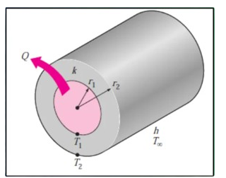
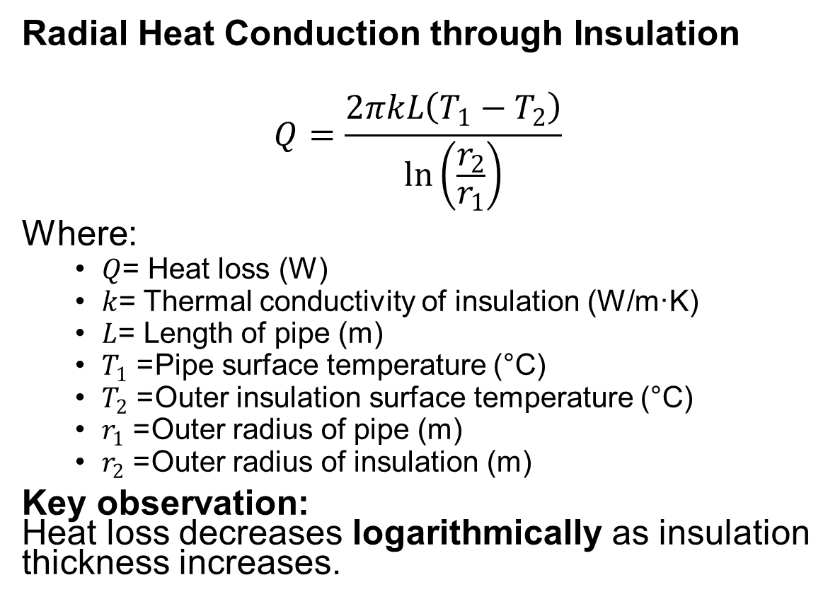
Heat Transfer Equation
Radial Heat Conduction through Insulation
$$Q=\frac{2πkL\left(T_{1}−T_{2}\right)}{\ln\left(\frac{r_{2}}{r_{1}}\right)}$$
Where:
  $Q$= Heat loss (W)
  $k$= Thermal conductivity of insulation (W/m·K)
  $L$= Length of pipe (m)
  $T_{1}$= Pipe surface temperature (°C)
  $T_{2}$= Outer insulation surface temperature (°C)
  $r_{1}$= Outer radius of pipe (m)
  $r_{2}$= Outer radius of insulation (m)
Key observation:
Heat loss decreases logarithmically as insulation thickness increases.
KAVINRAJA CHAKRAVARTHY
Kavinraja Chakravarthy

Slide 5
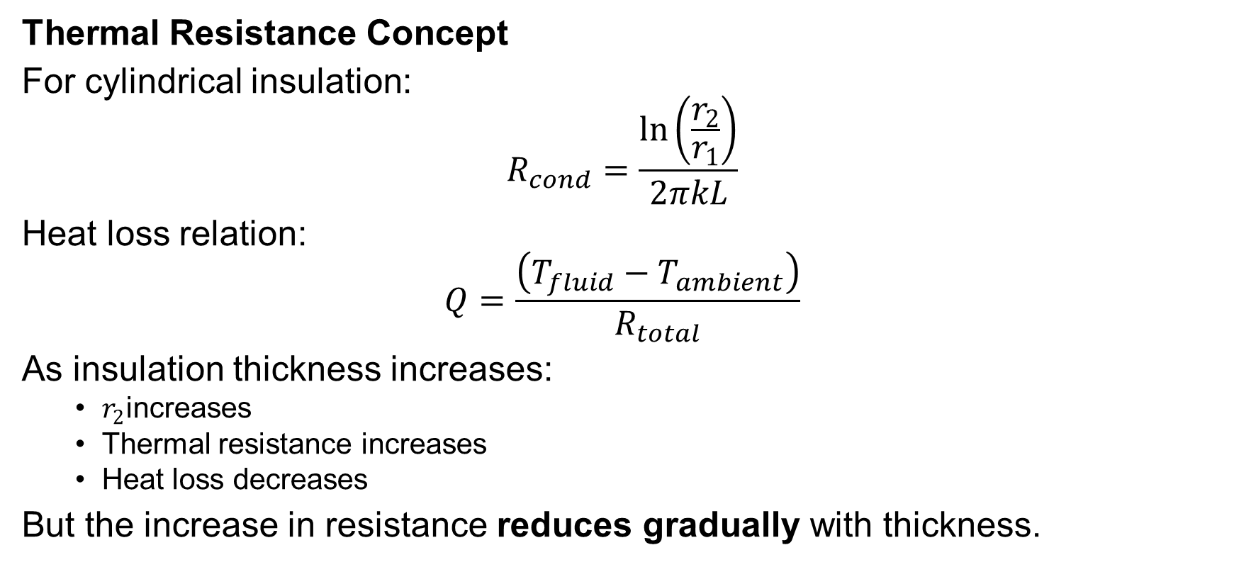
Insulation Thickness for a Hot Pipe
Thermal Resistance Concept
For cylindrical insulation:
$$R_{cond}=\frac{\ln\left(\frac{r_{2}}{r_{1}}\right)}{2πkL}$$
Heat loss relation:
$$Q=\frac{\left(T_{fluid}−T_{ambient}\right)}{R_{total}}$$
As insulation thickness increases:
  $r_{2}$increases
  Thermal resistance increases
  Heat loss decreases
But the increase in resistance reduces gradually with thickness.
KAVINRAJA CHAKRAVARTHY
Kavinraja Chakravarthy

Slide 6
Importance of Proper Insulation Thickness
Selecting the correct insulation thickness is a critical engineering decision in industrial piping systems.
Therefore, insulation thickness must be optimized, not maximized, to achieve an efficient and economical piping system
Feature | Too Thin Insulation | Too Thick Insulation
Energy Efficiency | High heat loss and energy waste | Limited additional reduction in heat loss (diminishing returns)
Cost | Low initial cost, but high operating cost | Higher material and installation cost
Safety & Operation | Unsafe surface temperatures | Difficult maintenance (due to bulk)
Process Control | Poor temperature control in the process | Good control, but potentially excessive for the requirement
KAVINRAJA CHAKRAVARTHY
Kavinraja Chakravarthy

Slide 7
Industrial Pipe Insulation: Materials & Selection
Common Industrial Insulation Materials
Selection Criteria:
  Low thermal conductivity
  Operating temperature limit
  Mechanical strength
  Cost and availability
Material | Thermal Conductivity (k) | Typical Use
Glass Wool | Low | Steam & hot water lines
Rock Wool | Moderate | High-temperature services
Calcium Silicate | Moderate | Refinery piping
Polyurethane Foam | Very low | Cold & moderate hot lines
KAVINRAJA CHAKRAVARTHY
Kavinraja Chakravarthy

Slide 8
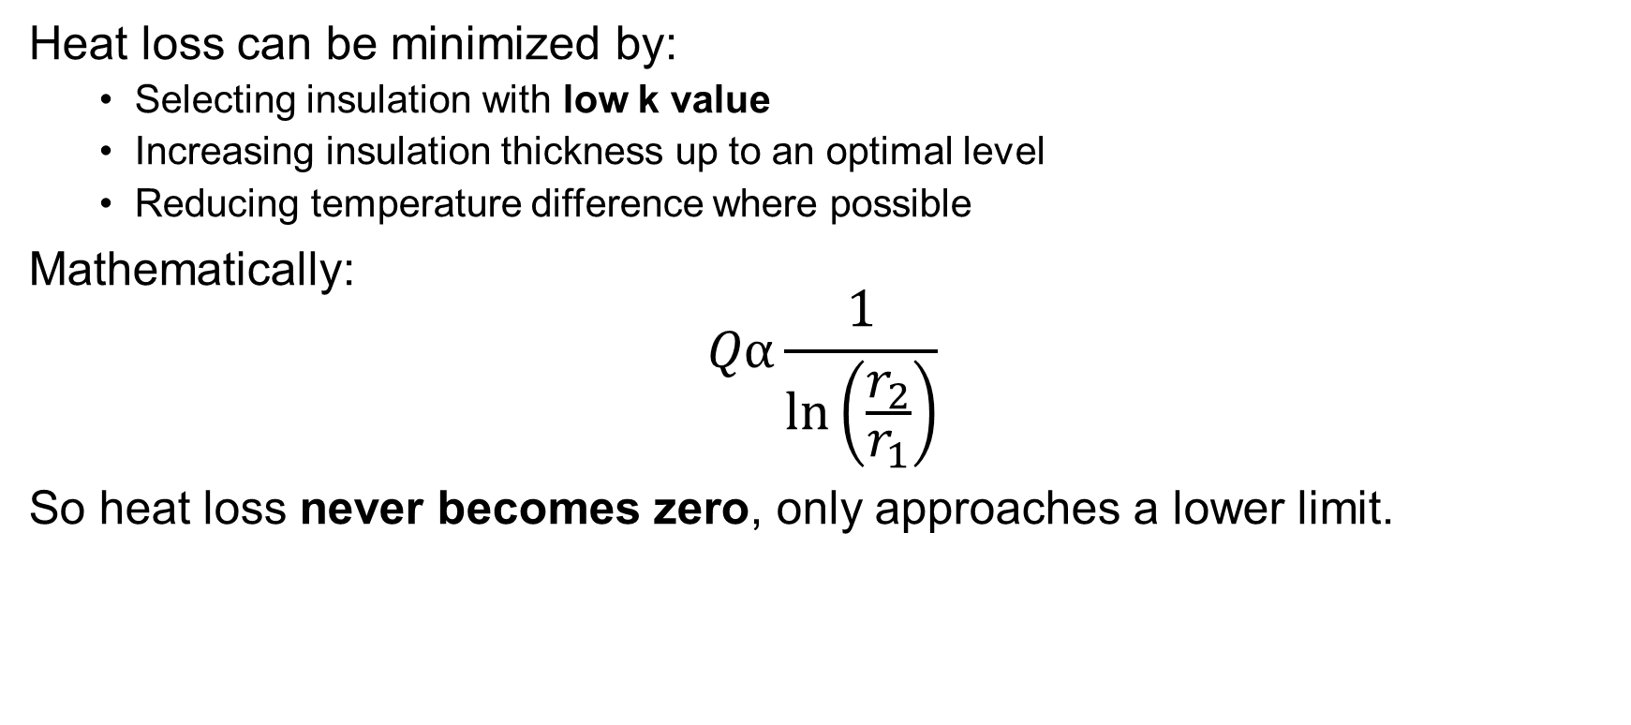
Minimizing Heat Loss in Insulated Piping Systems
Heat loss can be minimized by:
  Selecting insulation with low k value
  Increasing insulation thickness up to an optimal level
  Reducing temperature difference where possible
Mathematically:
$$Qα\frac{1}{\ln\left(\frac{r_{2}}{r_{1}}\right)}$$
So heat loss never becomes zero, only approaches a lower limit.
KAVINRAJA CHAKRAVARTHY
Kavinraja Chakravarthy

Slide 9
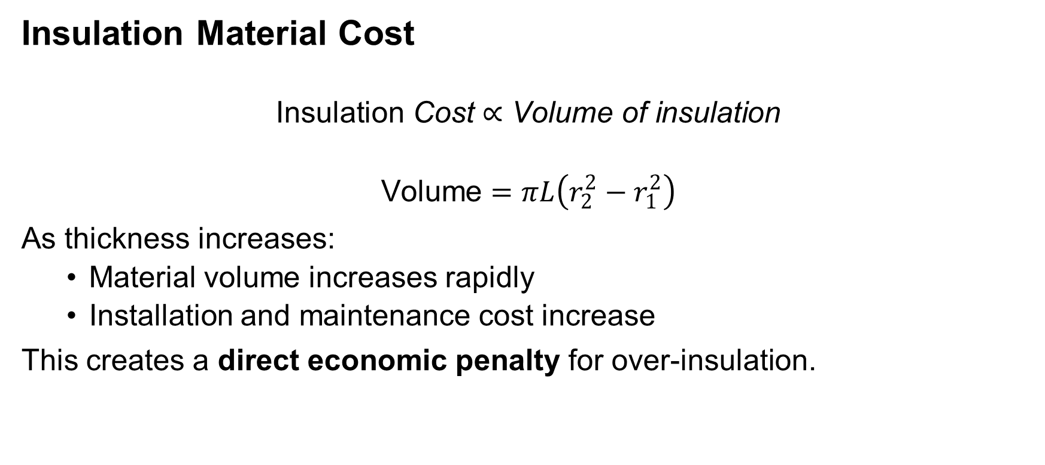
Insulation Cost Analysis
Insulation Material Cost
$$\text{Insulation} \text{Cost}∝\text{Volume} \text{of} \text{insulation}$$
$$\text{Volume}=πL\left(r_{2}^{2}−r_{1}^{2}\right)$$
As thickness increases:
  Material volume increases rapidly
  Installation and maintenance cost increase
This creates a direct economic penalty for over-insulation.
KAVINRAJA CHAKRAVARTHY
Kavinraja Chakravarthy

Slide 10
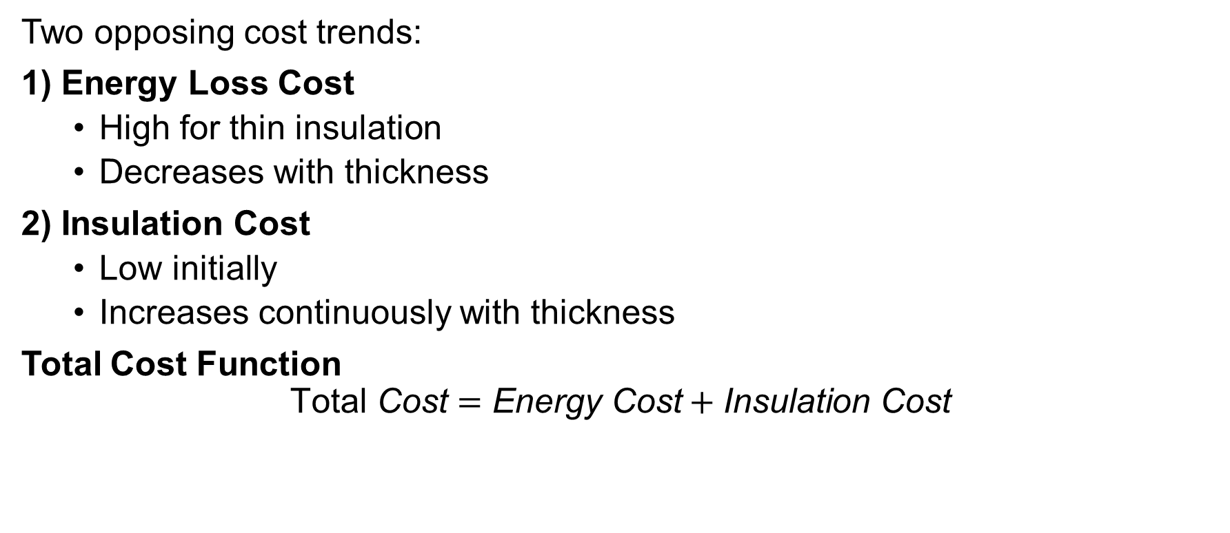
Minimizing Insulation Material Cost
Two opposing cost trends:
1) Energy Loss Cost
  High for thin insulation
  Decreases with thickness
2) Insulation Cost
  Low initially
  Increases continuously with thickness
Total Cost Function
$$\text{Total} \text{Cost}=\text{Energy} \text{Cost}+\text{Insulation} \text{Cost}$$
KAVINRAJA CHAKRAVARTHY
Kavinraja Chakravarthy

Slide 11
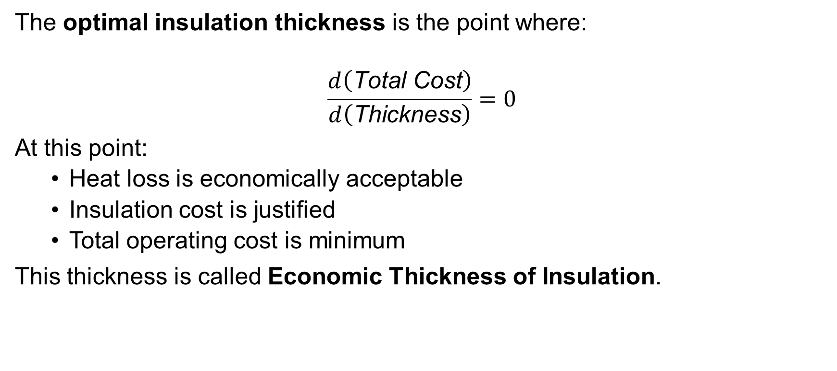
Economic Insulation Thickness
The optimal insulation thickness is the point where:
$$\frac{d\left(\text{Total} \text{Cost}\right)}{d\left(\text{Thickness}\right)}=0$$
At this point:
  Heat loss is economically acceptable
  Insulation cost is justified
  Total operating cost is minimum
This thickness is called Economic Thickness of Insulation.
KAVINRAJA CHAKRAVARTHY
Kavinraja Chakravarthy

Slide 12
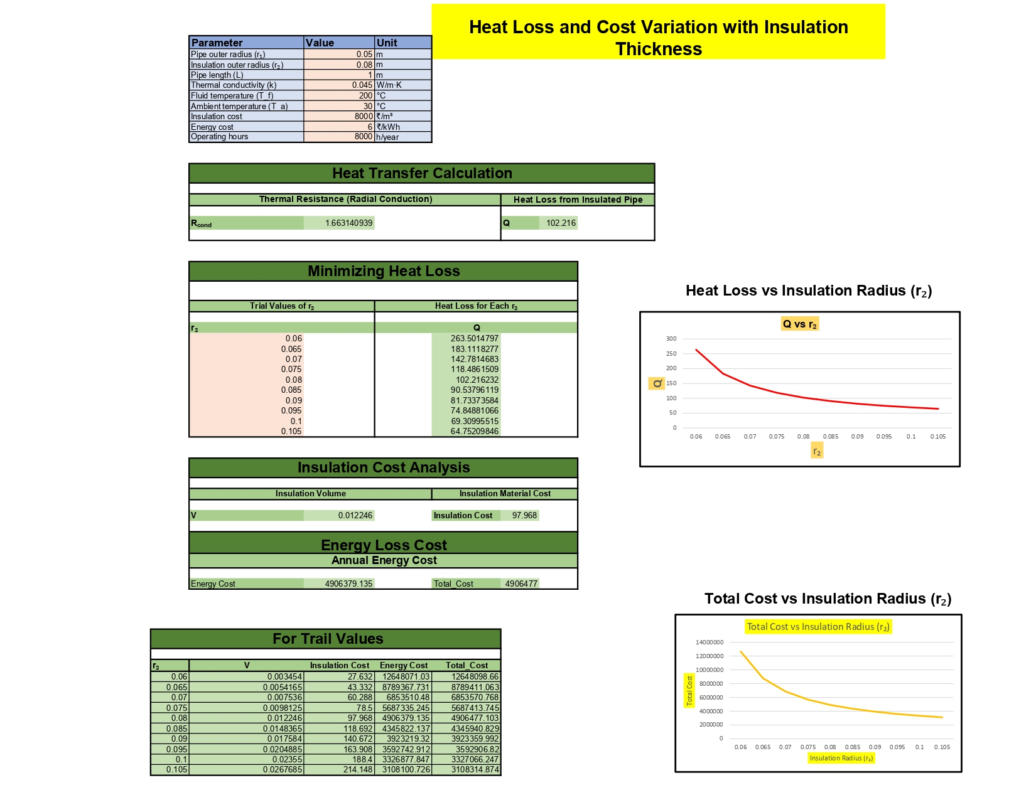
Sample( sheets)
KAVINRAJA CHAKRAVARTHY
Kavinraja Chakravarthy

Slide 13
Github repo / download link: https://github.com/kavinrajachakravarthy/Efficient-Thermal-Insulation-Design-for-Industrial-Pipelines
THANK YOU
KAVINRAJA CHAKRAVARTHY
Kavinraja Chakravarthy

